Slide 1
Learning
Saba Abid

Slide 2
Objectives:
To be able to understand:
The concept of learning
Factors affecting learning
Personality types
Personality types and learning styles

Slide 3
Learning

Slide 4
Definition of Learning
Learning is a relatively permanent change in behavior that results from experience.
Gales defined Learning as the behavioral modification which occurs as a result of experience as well as training.
Crow and Crow defined learning as the process of acquisition of knowledge, habits and attitudes.
According to E.A, Peel, Learning can be described as a change in the individual which takes place as a result of the environmental change.
H.J. Klausmeir described Learning as a process which leads to some behavioral change as a result of some experience, training, observation, activity, etc.

Slide 5
Factors affecting Learning
Why to study about the factors affecting learning ?

Slide 6
Psychological Factors
Readiness / Preparedness
Interest
Intelligence
Motivation
Frustration
Aptitude
Mental Health
Individual Differences
Rewards and Punishments

Slide 7
Readiness / Preparedness
To be mentally ready to learn a skill is called Readiness.
Teaching is a pleasant thing and it would be pleasant only if your students are internally ready for learning
Interest:
An interest is a subjective attitude motivating a person to perform a certain task.
Interest is a feeling or emotion that causes attention to focus on an object, event, or process.
Intelligence
Intelligence is the ability to learn from experience, solve problems, and use our knowledge to adapt to new situations.

Slide 8
Motivation
Motivation is an urge to behave or act in a way that will satisfy certain conditions, such as wishes, desires, or goals.
Motivation is the "why" behind human actions.
Extrinsic VS Intrinsic motivation
Extrinsic motivations are those that arise from outside of the individual and often involve rewards such as trophies, money, social recognition, or praise.
Intrinsic motivations are those that arise from within the individual.

Slide 9
Frustration
The feeling of being upset or annoyed, especially because of inability to change or achieve something is called frustration.
Frustration is an emotion that occurs in situations where a person is blocked from reaching a desired outcome.
Frustration is caused by a lack of control over a situation. The best way to handle frustration is to back away from the problem, take a breath, and then approach the problem calmly and rationally
In general, whenever we reach one of our goals, we feel pleased and whenever we are prevented from reaching our goals, we may succumb to frustration and feel irritable, annoyed and angry.
IS FRUSTRATION ALWAYS BAD FOR YOU?

Slide 10
Aptitude
An aptitude is an innate inborn ability or capacity to learn to do a certain kind of work.
Aptitude is the potential in the student, which has as yet not been tapped and trained to a skill level. A student, who possesses appropriate aptitude for a particular subject of study or skill, will learn better and retain it for a longer time.

Slide 11
Mental Health
A person’s condition with regard to his psychological and emotional well-being
Mental health is also defined as a state of well-being in which every individual realizes his or her own potential, can cope with the normal stresses of life, can work productively and fruitfully, and is able to make a contribution to her or his community.
Mental tension, complexes, conflicts, mental illnesses and mental diseases hamper learning. A maladjusted child finds it difficult to concentrate. Concentration needs mental poise and absence of mental conflict or complex. Some pupils find it difficult to prepare for the university examination, simply because of fear of the examination and anxiety neurosis. A calm, serene and balanced mind her the power to concentrate and learn better.

Slide 12
Individual differences
Individual differences are the more-or-less stable psychological characteristics that distinguish one person from another and thus help to define each person's individuality.
Learners have different strategies, approaches, and capabilities for learning that are a function of prior experience and heredity.
Rewards and Punishment
Rewards of all sorts are powerful incentives to learn if use properly. But these rewards are more abused than used properly. Sometimes students become over-dependent on rewards. They refuse to work without any incentive of reward. All learning should not be and cannot be rewarded immediately.
Punishments, arousing fear in anticipation, may influence the pupil to work and learn, but not in all the cases. Sometimes punishment creates bad reaction, retaliation, hatred and disgust. Experimental studies show that punishment interfere with complex learning activities, when punishments become frequent. Absence of punishment becomes a basis of low activity on the part of the pupil.

Slide 13
Other factors
Include physiological and environmental factors.
Physical health
Fatigue
Time of learning
Food and Drink
Working conditions
Age

Slide 14
Physical health
Ill health hampers learning. Sound mind is only in a sound body. Sound physical health gives strength and energy to pursue learning activities for a longer education. A diseased person is handicapped by the normal physical strength necessary for any mental activity.
Fatigue
Muscular or sensory fatigue causes mental boredom . A number of factors in the environment may cause physical and mental fatigue which can affect learning.
Time of learning
Morning and evening hours are the best periods of study. During the day, there is decline in the mental capacity. Experiments on children have shown that there are great variations in learning efficiency during the different hours of the day.

Slide 15
Food and Drink
Nutrition is responsible for efficient mental activity. Poor nutrition adversely affects learning. The type of food also has some effect.
Working conditions
Learning is hampered by bad working conditions such as distraction, noise, poor illumination, bad ventilation, overcrowding, bad seating arrangement, and uncomfortable stay both at home and school.
Age
Learning capacity varies with age. Some subjects can better be learnt at the early age, and some during adulthood.

Slide 16
Teaching Method
Importance of this factor?
Teaching style
Organization of material
Evaluation procedure
Classroom interaction

Slide 17
Personality types
Myers-Briggs Type Indicator (MBTI):
Explains personality types in greater depth, which can be useful:
In developing strategies for more effective study
Better time management
More successful relationships
Selecting courses and majors

Slide 18
The eight traits from the MBTI are arranged in four continuums or preferences scales:
Extravert (E)……….. Introvert (I)
Sensing (S) ………… Intuitive (N)
Thinking (T) ………… Feeling (F)
Perceiving (P)……… Judging (J)
There is no right or wrong to these preferences – each identifies normal behaviors and characteristics

Slide 19
Eight traits | Description
Extravert – Introvert (E – I) | Where do I prefer to get and focus my attention and “energy”?
Sensing – Intuitive (S –N) | How do I prefer to take in information?
Thinking – Feeling (T – F) | How do I evaluate and come to conclusions about information and how I make decisions?
Judging – Perceiving (J –P) | How do I prefer to deal with the world around me, my “lifestyle” ?

Slide 20


Slide 21
Extravert – Introvert (E-I)
This scale explains where people tend to focus their attention and get their energy.
Extravert (E):
Extraverts (E) tend to focus on the outer world of people, things, and activity and are energized by interaction with others.
They love to talk, participate, organize, and socialize.
Extraversion is described as an outgoing, open and accommodating nature that adapts easily to a given situation.
Energy and attention flow out to the objects and people in the environment.

Slide 22
Introvert (I):
Introverts (I) are energized by the inner world of reflection and thoughts.
They direct their energy and attention inward and receive energy from reflecting on their thoughts, memories and feelings.
They can be sociable but need space and time.
Introverts want to understand the world.
They prefer to figure out things before they talk about them.
They desire to focus on the internal, subjective state, to affirm its value and to maintain this focus as long as possible.

Slide 23
The two attitudes do not represent a dichotomy. Every personality has both introvert and extravert characteristics. However, in every personality one attitude, for example, extraversion, is dominant and conscious, while the other attitude is subordinate and unconscious. The subordinate attitude compensates for the dominant attitude and vice versa.
However, this does not mean that one attitude is healthy and the other not. Both may have positive and negative consequences for development. Introversion may be positive or negative. Similarly, extraversion may be positive or negative.

Slide 24
Self-assess: Your preference?
Extravert Introvert

Slide 25
Sensing – Intuitive (S-N)
This scale suggests how people take in information and ways that they become aware of the things, people, events, or ideas. It has biggest impact on how people learn.
Sensing (S):
Sensing (S) people rely heavily on their five sense to take in information.
They take in information that is real and tangible – What is actually happening.
They are interested in what is real, immediate, practical, and observable by the senses.
They are observant about the specifics of what is going on around them and are especially attuned to practical realities, and therefore they are practical and realistic.
They focus on details and may ignore the big picture.
They would rather do than think.

Slide 26
Intuitive (N):
Intuitive (N) people trust their gut feelings and intuition and look for the ‘big picture’.
Since they see the big picture, they often ignore the details.
They are interested in future possibilities, implicit meanings, abstract, and symbolic or theoretical patterns suggested by insight.
They would rather think than do.
It differs from sensation in that it is more creative.

Slide 27
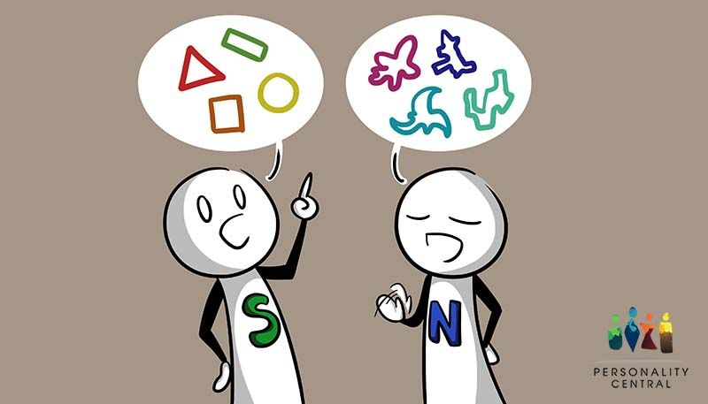

Slide 28
Self-assess: Your preference?
Sensing Intuitive

Slide 29
Thinking – Feeling (T-F)
This scale explains the way people evaluate and come to conclusions about information and how they make decisions.
Thinking (T):
Thinking (T) people look at the logical consequences of a choice or action and decide on the basis of logic, analysis, and reason.
They analyze to identify what’s wrong with something so they can solve the problem.
They strive to find a standard or principle that they will apply in similar situations.
They follow their mind rather than their heart and sometimes appear blunt and uncaring about the feelings of others.

Slide 30
Feeling (F):
Feeling (F) people decide on the basis of their feelings, personal likes and dislikes.
Feeling people, when making decisions, like to consider what is important to them and to others involved.
Appreciating and supporting others energizes them.
They strive to create harmony and treat each person as a unique individual.
They want others to like them so find it difficult to say no or disagree with others.
They feel rewarded when they can help others.

Slide 31
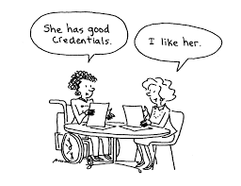

Slide 32
Self-assess: Your preference?
Thinking Feeling

Slide 33
Judging – Perceiving (J-P)
This range suggests the type of life style and work habits people prefer.
Judging (J):
Judging (J) people like to live in a planned, orderly way, seeking to regulate and manage their lives.
They want to make decisions, come to conclusions, and move on.
They tend to be structured and organized and like to have things settled.
Getting things done energizes them.
They focus on completing the task, only want to know the essentials, and take actions quickly (sometimes too quickly).

Slide 34
Perceiving (P):
Perceiving (P) people enjoy being curious and open to changes, prefer to keep options open in case something better turns up.
They are spontaneous and don’t like to be boxed in by deadlines or plans.
They like to postpone action and seek more data, gathering more information before making decisions.
They prefer to stay open to new information and last-minute options.
They work at many things at once.
They are flexible and often good in emergencies when plans are disrupted.

Slide 35
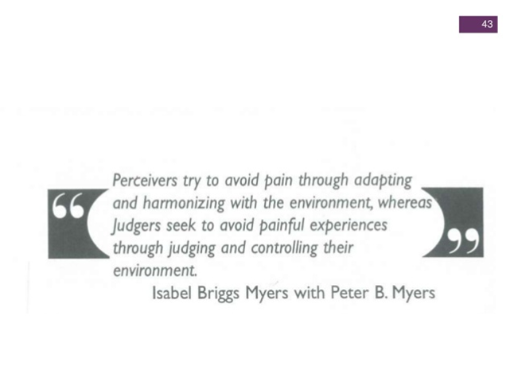


Slide 36
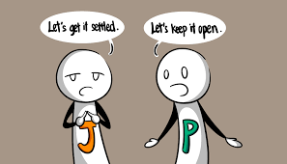

Slide 37
Self-assess: Your preference?
Judging Perceiving

Slide 38
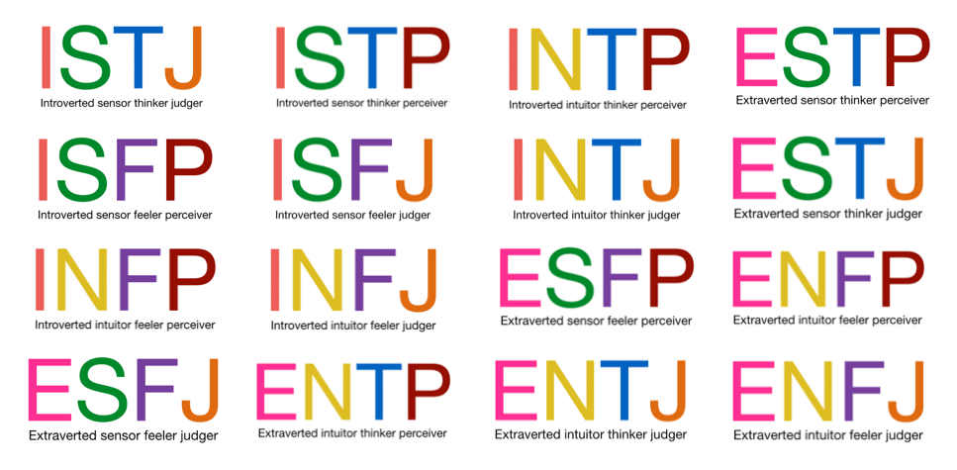
The 16 personality types

Slide 39
Personality types and learning patterns
Extraverted Type and Learning Style
Extraverted types learn best by talking and physically engaging the environment.
Talking helps their thoughts to form and become clear.
Their attention will naturally flow towards external things and events.
Extraverted Types in the Classroom
Extraverted students work best in classrooms that allow time for discussion, talking and/or working with a group.
Since they are action oriented, Es do well with activities involving some type of physical activity.
They sometimes find listening difficult and need to talk to work out their ideas.

Slide 40
Introverted Types and Learning Style
Introverts learn best through quiet, mental reflection.
Their attention will naturally flow inward to their own thoughts, ideas and impressions.
Introverted Types in the Classroom
Introverted students tend to enjoy reading, lectures, and written over oral work.
They prefer to work independently, do well at verbal reasoning, and need time for internal(mental) processing.
They enjoy listening to others talk about a topic while privately processing the information.
Introverts may encounter difficulty with instructors who speak quickly without allowing time for mental processing.
They are often uncomfortable in discussion groups, may find it difficult to remember names, and hesitate to speak up in class.

Slide 41
Sensing Types and Learning Style
Sensing types like concrete facts, organization, and structure.
They are good at memorization and are relatively conventional.
Sensing Types in the Classroom
They like to go step by step and are best at tasks that call for carefulness, observing specifics, and have a practical interest.
They feel more comfortable using skills already learned than learning new ones and become easily frustrated and impatient with complicated situations.
They understand ideas and theories through practical applications.
They need to start with the familiar, solid facts before they can gradually move toward abstract concepts and principles.
Sensing students like outlines, clear guidelines, and specifics.
Sensing students read the question several times before answering it to be certain they understand it.
They often have difficulty with theory.

Slide 42
Intuitive Types and Learning Styles
Intuitive types want to know the theory before deciding that facts are important, focusing on general concepts more than details and practical matters.
They quickly see associations and meanings, relying more on insight than observation.
Intuitive Types in the Classroom
They are creative, innovative and work with bursts of energy.
They desire only a general outline, and enjoy new material.
They are best with tasks that appeal to their intellectual interests and call for grasping general concepts, seeing relationships, and using imagination.
Intuitive students may not read a test question all the way through, sometimes missing a key part, because they act on their hunches.
Once they understand a concept or skill, they may find continued repetition or practice boring.
They might become frustrated with instructors who pace the material too slowly for them.

Slide 43
Thinking Types and Learning Styles
Thinking types use logical analysis to understand material.
They analyze experiences and material to find logical principles underlying them, and they analyze problems to bring logical order out of confusion
Thinking Types in the Classroom
They naturally critique things, making them good at problem solving when they can analyze to identify what’s wrong with something.
They focus on tasks and do best with objective material to study and enjoy going into depth.
They strive to get a sense of mastery over the material being studied.
They may have difficulty with instructors who do not present material in a logical order.
They like clear course and topic objectives that are precise and action-oriented.

Slide 44
Feeling Types and Learning Styles
Feeling types look for a personal connection in classroom material, seeking to relate ideas and concepts to personal experiences.
Feeling Types in the Classroom
They enjoy working in groups as long as individual relationships develop.
They learn well by helping others and responding to their needs, and they study well with others.
Feeling types do best with topics of study they care about and might have difficulty with topics that do not relate to people or relationships.
They need to develop a personal rapport with the instructor and receive feedback and encouragement.
They may have difficulty with instructors who appear impersonal or detached.

Slide 45
Judging Types and Learning Styles
Judging types plan their work and stick to the plan, often getting work done early.
Judging Types in the Classroom
They do well with formalized instruction and defined tasks.
They meet deadlines, like planning, and prefer to work on only one thing at a time.
They avoid last-minute stresses and don’t work well under last-minute pressure.
They dislike surprises and thrive on order.
They want to know what they are accountable for and by what standards they will be graded.
They treat assignments seriously.

Slide 46
Perceiving Types and Learning Styles
Perceiving types start many tasks, want to know everything about each task, and often find it difficult to complete them.
Perceiving Types in the Classroom
They work in flexible ways.
Their biggest problem is procrastination.
They are stimulated by the new and different ideas.
They study best when surges of impulsive energy come to them.
They are good at casual problem solving and adept at managing arising problems.
They may make a calendar of things to do but often won’t follow it.
They feel energized by last-minute pressures and often do their best work under pressure.
They need to find novel ways to do routine assignments to increase their interest.
They don’t mind surprises.

Slide 47
Is frustration always bad for you?
Frustration is not necessarily bad since it can be a useful indicator of the problems in a person's life and, as a result, it can act as a motivator to change. However, when it results in anger, irritability, stress, resentment, depression, or a spiral downward where we have a feeling of resignation or giving up, frustration can be destructive.
Difference between Intelligence and Aptitude
Intelligence | Aptitude
• Intelligence is General mental ability | • Aptitude is Specific ability of a person
• The knowledge of intelligence of an individual we can predict his success in a number of situations involving mental function or activity | • The knowledge of Aptitude, on other hand, acquaints us with the specific abilities and capacities of an individual to succeed in a particular field of activity.
• Wide scope | • Narrow scope
• It refers to present ability | • It refers to future potentiality
• It usually measured by how much a person knows and can do certain areas | • It usually measured by how well a person can perform certain task

